Slide 1
Introduction to Parallel Computing
Sonia Gupta
HPC Team, TCS Pune

Slide 2
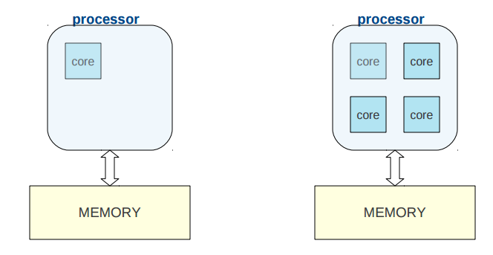
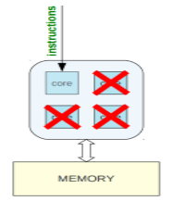
Why Parallel computing
In case of Sequential program: Waste of available resources. Only one core is utilized. Rest of cores are utilized. But we want all cores to be utilized. Hence parallel computing comes in to picture.

Slide 3
Parallel Computing
Multi-core computing
Pthreads
OpenMP
Distributed computing
MPI
Hetrogeneous computing
GPGPU Programming

Slide 4
Threads vs. Processes
How threads and processes are similar
Each has its own logical control flow
Each can run concurrently
Each is context switched
How threads and processes are different
Threads share code and data, processes do not
Threads are somewhat less expensive than processes i.e number of machine cycles required to manage threads is lesser than process
Process management is expensive as thread control

Slide 5
Traditional View of a Process
Process = process context + code, data, and stack
Process context
Code, data, and stack
Program context:
Data registers
Condition codes
Stack pointer (SP)
Program counter (PC)
Kernel context:
VM structures
Descriptor table
brk pointer
stack
SP
shared libraries
brk
run-time heap
read/write data
PC
read-only code/data
0

Slide 6
Alternate View of a Process
Process = thread + { code, data, and kernel context }
Thread (main thread)
Code and Data
shared libraries
SP
stack
brk
run-time heap
Thread context:
Data registers
Condition codes
Stack pointer (SP)
Program counter (PC)
read/write data
PC
read-only code/data
0
Kernel context:
VM structures
Descriptor table
brk pointer

Slide 7
Parallel Programming using OpenMP
Sonia Gupta
HPC Team, TCS Pune

Slide 8
What is OpenMP?
API for writing shared memory applications in C,C++ and Fortran
OpenMP API consists of:
Compiler Directives
Runtime subroutines/functions
Environment variables

Slide 9
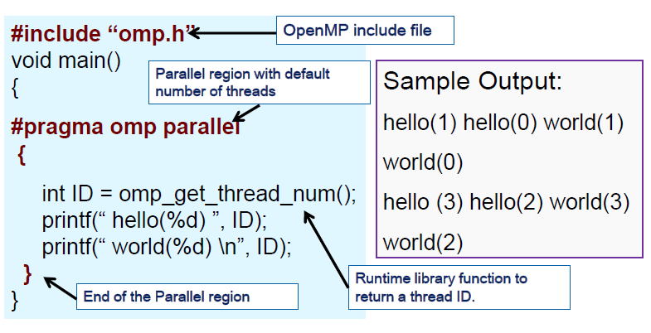
Hello World Program
Compiling:
Intel: icc –openmp test.c –o out.exe
Gnu: g++ -fopenmp test.c –o out.exe
Running:
EXPORT OMP_NUM_THREADS=4
./out.exe

Slide 10
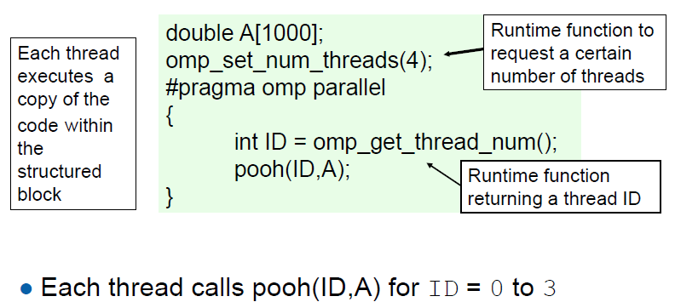
Creating Threads
Threads are created using parallel construct
To create 4 threads, use
omp_set_num_threads(4)

Slide 11
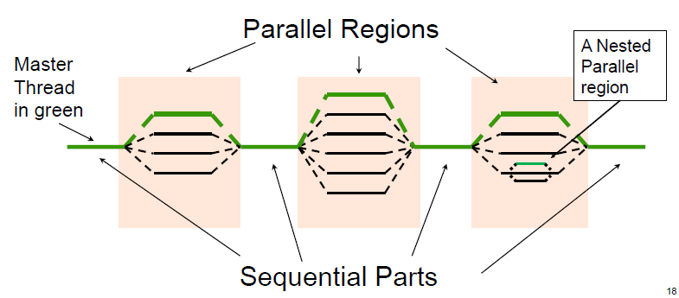
OpenMP Execution
Master thread spawns a team of threads as needed.
Parallelism through multiple threads
*

Slide 12
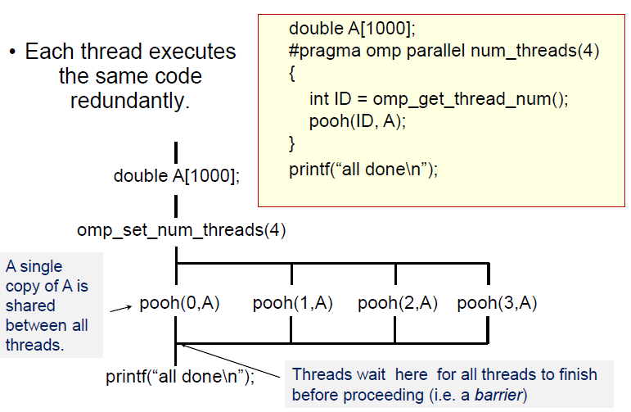
Creating threads

Slide 13
More about OpenMP Threads
Number of openMP threads can be set using: Environmental variable OMP_NUM_THREADS
Runtime function omp_set_num_threads(n)
Other useful function to get information about threads:
Runtime function omp_get_num_threads()
Returns number of threads in parallel region
Returns 1 if called outside parallel region
Runtime function omp_get_thread_num()
Returns id of thread in team
Value between [0,n-1] // where n = #threads
Master thread always has id 0

Slide 14
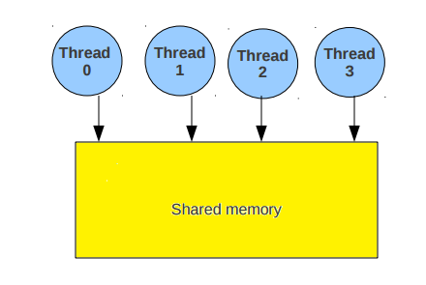
OpenMP Threads versus Cores
What are threads,cores and how are they related?
Thread is independent sequence of execution of program code Block of code with one entry and one exit
Unrelated to Cores/CPUs OpenMP threads are mapped onto physical cores
Possible to map more than 1 thread on a core
In practice best to have one-to-one mapping.
Memory is shared by all the cores and the corresponding OMP threads

Slide 15
Shared and Private Variables
OpenMP provides a way to declare variables private or shared within an OpenMP block.
This is done using OpenMP clauses shared and private
SHARED ( list ) - #pragma omp parallel shared(u,v,w)
All variables in list will be considered shared.
Every openmp thread has access to all these variables
PRIVATE ( list ) - #pragma omp parallel private(a,b,c)
Every openmp thread will have it's own ”private” copy of variables in list
No other openmp thread has access to this ”private” copy

Slide 16
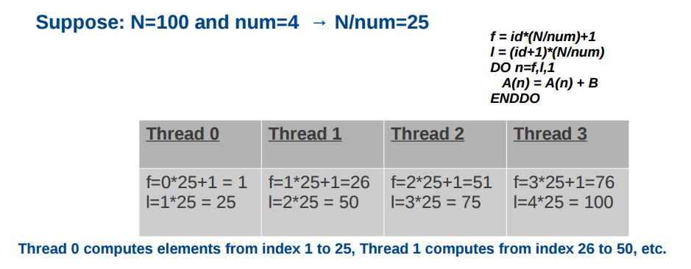
Work sharing
Objective: we want is to share work among all threads so we can solve our problems faster
#pragma omp parallel private(n,num,id,f,I)
Id = omp_get_thread_num()
Num = omp_get_num_threads()
f = id*(N/num)+1
I = (id+1)*(N/num)
for(int n=f;n<I;n++)
{ A(n) = A(n) + B; }
Partition the iteration space manually, every thread computes N/num iterations

Slide 17
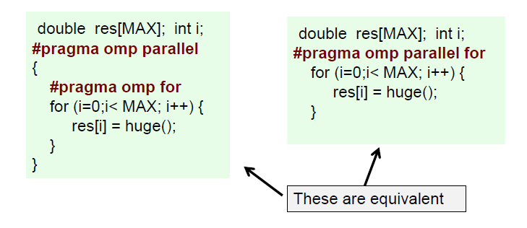
Work Sharing: Parallel For
Code given inside a Parallel For is executed in parallel
Variable i is private to each
The for loop range is divided equally among all the threads

Slide 18
Dynamic Scheduling
Dynamic Scheduling: After each iteration, the threads must stop and receive a new value of the loop variable to use for its next iteration.
#pragma omp parallel for schedule(dynamic) num_threads(THREADS)
Dynamic with chunk size: each thread will take a set number of iterations, called a “chunk”, execute it, and then be assigned a new chunk when it is done.
#pragma omp parallel for schedule(dynamic, CHUNK) num_threads(THREADS)
Dunamic with guided: This scheduling policy is similar to a dynamic schedule, except that the chunk size changes as the program runs. It begins with big chunks, but then adjusts to smaller chunk sizes if the workload is imbalanced.
#pragma omp parallel for schedule(guided) num_threads(THREADS)

Slide 19
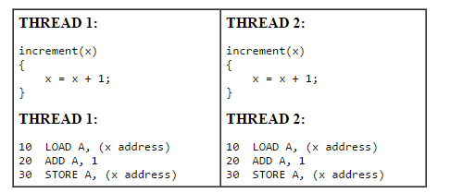
Synchronization
Consider a simple example where two threads on two different processors are both trying to increment a variable x at the same time (assume x is initially 0):
One possible execution sequence:Thread 1 loads the value of x into register A.
Thread 2 loads the value of x into register A.
Thread 1 adds 1 to register A
Thread 2 adds 1 to register A
Thread 1 stores register A at location x
Thread 2 stores register A at location x
The resultant value of x will be 1, not 2 as it should be.
To avoid a situation like this, the incrementing of x must be synchronized between the two threads to ensure that the correct result is produced.
OpenMP provides a variety of Synchronization Constructs that control how the execution of each thread proceeds relative to other team threads.

Slide 20
MASTER directive
Purpose
The MASTER directive specifies a region that is to be executed only by the master thread of the team. All other threads on the team skip this section of code
There is no implied barrier associated with this directive
Format
#pragma omp master
{
some instructions;
}
Restrictions
It is illegal to branch into or out of the MASTER block

Slide 21
CRITICAL example
#include <omp.h>
main()
{
int x;
X = 0;
#pragma omp parallel shared(x)
{
#pragma omp critical
x=x+1
}/*end of parallel section*/
}

Slide 22
BARRIER directive
Purpose
The BARRIER directive synchronises all threads in a team
When a BARRIER directive is reached, a thread will wait at that point until all other threads have reached that barrier. All threads then resume executing in parallel the code that follows the barrier
Format
#pragma omp barrier
Restrictions
All threads in the team must execute the BARRIER

Slide 23
Runtime Environment routines
Modify/Check the number of threads
omp_set_num_threads(), omp_get_num_threads(), omp_get_thread_num(), omp_get_max_threads()
Are we in an active parallel region?
omp_in_parallel()
Do you want the system to dynamically vary the number of threads from one parallel construct to another?
omp_set_dynamic, omp_get_dynamic();
How many processors in the system?
omp_get_num_procs()

Slide 24
Parallel Programming using MPI
Sonia Gupta
HPC Team, TCS Pune

Slide 25
Sequence
Message passing
Synchronous/Asynchronous message transfer
What is MPI?
“Hello World” Program
Blocking Send/Recv
Non-blocking Send/Recv
Deadlocks
Collectives
- Bcast
- Reduce
- Scatter/Gather
- Allgather
PI Example
MPI-2/MPI-3
References

Slide 26
What is message passing?
Message Passing Interface (Data transfer)
Requires involvement of sender and receiver
Data transfer can be synchronous and asynchronous:
A synchronous communication is not complete until the message has been received.
An asynchronous communication completes as soon as the message is on the way.

Slide 27
What is MPI?
A message-passing library specifications:
Not a language or compiler specification
Not a specific implementation or product
For parallel computers, clusters, and heterogeneous networks.
Communication modes: standard, asynchronous
Designed to permit the development of parallel software libraries.
Two MPI libraries are there. 1) IntelMPI. 2) OpenMPI

Slide 28
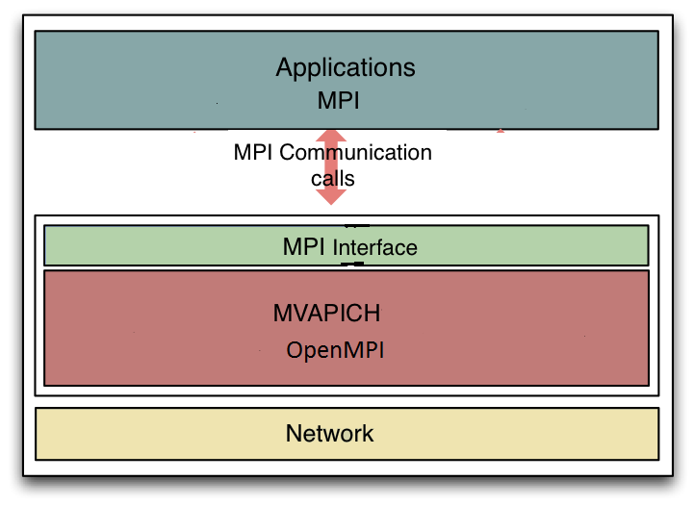
MPI on System

Slide 29
A Minimal MPI Program (C)
#include "mpi.h"
#include <stdio.h>
int main( int argc, char *argv[] )
{
MPI_Init( &argc, &argv );
printf( "Hello, world!\n" );
MPI_Finalize();
return 0;
}
Compiling:
> mpicc hello.c
To create 10 instances
>mpirun –np 10 ./a.out
To give nodes:
mpirun –np 5 –host node1,node1,node2,node3,node3 ./a.out

Slide 30
Information About Environment
Total number of processes participating gives the size. So what is the size?
MPI_Comm_size() reports the number of processes.
Every process is identified by a rank.
What is my rank?
MPI_Comm_rank() reports the rank, a number between 0 and size-1, identifying the calling process

Slide 31
Better Hello (C)
#include "mpi.h"
#include <stdio.h>
int main( int argc, char *argv[] )
{
int rank, size;
MPI_Init( &argc, &argv );
MPI_Comm_rank( MPI_COMM_WORLD, &rank );
MPI_Comm_size( MPI_COMM_WORLD, &size );
printf( "I am %d of %d\n", rank, size );
MPI_Finalize();
return 0;
}
Default communicator
Processes ID in communicator
Processes in a communicator
mpirun –np 2 ./a.out
Output:
I am 0 of 2
I am 1 of 2

Slide 32
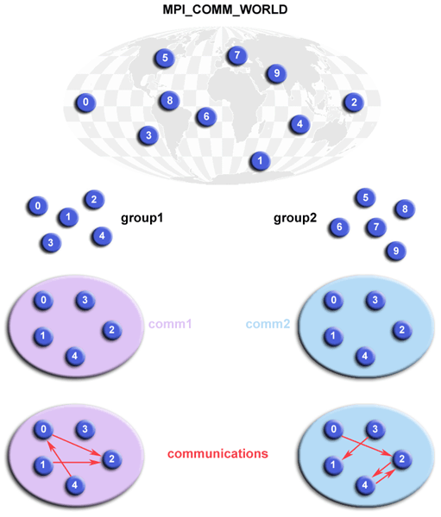
Basic Concepts

Slide 33
What is message passing?
Data transfer plus synchronization
Process 0
Data
May I Send?
Data
Data
Data
Data
Data
Data
Data
Data
Process 1
Yes
Time

Slide 34
MPI blocking send
MPI_SEND(void *start, int count,MPI_DATATYPE datatype, int dest, int tag, MPI_COMM comm)
The message buffer is described by (start, count, datatype).
dest is the rank of the target process in the defined communicator.
tag is the message identification number.

Slide 35
MPI blocking receive
MPI_RECV(void *start, int count, MPI_DATATYPE datatype, int source, int tag, MPI_COMM comm, MPI_STATUS *status)
Source is the rank of the sender in the communicator.
The receiver can specify a wildcard value for source (MPI_ANY_SOURCE) and/or a wildcard value for tag (MPI_ANY_TAG), indicating that any source and/or tag are acceptable
Status is used for extra information about the received message if a wildcard receive mode is used.
If the count of the message received is less than or equal to that described by the MPI receive command, then the message is successfully received. Else it is considered as a buffer overflow error.

Slide 36
Datatypes
Since all data is labeled by type, an MPI implementation can support communication between processes on machines with very different memory representations and lengths of elementary datatypes (heterogeneous communication).
Specifying application-oriented layout of data in memory
- reduces memory-to-memory copies in the implementation
- allows the use of special hardware (scatter/gather) when available

Slide 37
Basic MPI types
MPI datatype C datatype
MPI_CHAR signed char
MPI_SIGNED_CHAR signed char
MPI_UNSIGNED_CHAR unsigned char
MPI_SHORT signed short
MPI_UNSIGNED_SHORT unsigned short
MPI_INT signed int
MPI_UNSIGNED unsigned int
MPI_LONG signed long
MPI_UNSIGNED_LONG unsigned long
MPI_FLOAT float
MPI_DOUBLE double
MPI_LONG_DOUBLE long double

Slide 38
Tags
Aim is to use it for Separation of messages.
Arbitrary non-negative integer assigned by the programmer to uniquely identify a message.
Send and receive operations should match message tags. For a receive operation, the wild card MPI_ANY_TAG can be used to receive any message regardless of its tag.
The MPI standard guarantees that integers 0-32767 can be used as tags, but most implementations allow a much larger range than this.

Slide 39
MPI_STATUS
Status is a data structure
In C:
int recvd_tag, recvd_from, recvd_count;
MPI_Status status;
MPI_Recv(…, MPI_ANY_SOURCE, MPI_ANY_TAG, …, &status)
recvd_tag = status.MPI_TAG;
recvd_from = status.MPI_SOURCE;
MPI_Get_count(&status, datatype, &recvd_count);

Slide 40
MPI is Simple
Many parallel programs can be written using just these six functions
MPI_INIT
MPI_FINALIZE
MPI_COMM_SIZE
MPI_COMM_RANK
MPI_SEND
MPI_RECV

Slide 41
Non-Blocking Send and Receive
MPI_ISEND(buf, count, datatype, dest, tag, comm, request)
MPI_IRECV(buf, count, datatype, dest, tag, comm, request)
request is a request handle which can be used to query the status of the communication or wait for its completion.
MPI_WAIT (request, status)
MPI_TEST (request, flag, status)
The MPI_WAIT will block your program until the non-blocking send/receive with the desired request is done.
The MPI_TEST is simply queried to see if the communication has completed and the result of the query (TRUE or FALSE) is returned immediately in flag

Slide 42
Non-Blocking Send and Receive (Cont.)
A non-blocking send call indicates that the system may start copying data out of the send buffer. The sender must not access any part of the send buffer after a non-blocking send operation is posted, until the complete-send returns.
A non-blocking receive indicates that the system may start writing data into the receive buffer. The receiver must not access any part of the receive buffer after a non-blocking receive operation is posted, until the complete-receive returns.

Slide 43
MPI_Isend/MPI_Irecv
Rank = 0
MPI_Isend(..,request1)
MPI_IRecv(..,request2)
….. Do something
/*wait for completion ..blocking*/
MPI_Wait(…,&request1);
MPI_Wait(…,&request2);
/*check whether the request was successfully completed*/
MPI_Test(request1,..,status1);
MPI_Test(request2,..,status2);
If(status1 == MPI_SUCCESS)
printf(“message 1 successful);
If(status2 == MPI_SUCCESS)
printf(“message 2 successful);
Rank = 1
MPI_IRecv(..,request1)
MPI_Isend(…,request2)
…..Do something
/*wait for completion ..blocking*/
MPI_Wait(..,&request1);
MPI_Wait(..,&request2);
/*check whether the request was successfully completed*/
MPI_Test(request1,..,status1)
MPI_Test(request2,..,status2)
If(status1 == MPI_SUCCESS)
printf(“message 1 successful);
If(status2 == MPI_SUCCESS)
printf(“message 2 successful);

Slide 44
Deadlocks in blocking operations
What happens with
Process 0 Process 1
Send(1) Send(0)
Recv(1) Recv(0)
Send a large message from process 0 to process 1
If there is insufficient storage at the destination, the send must wait for the user to provide the memory space(through a receive)
This is called “”unsafe” because it depends on the availability of system buffers.

Slide 45
Some solutions to the “”unsafe” problem
Order the operations more carefully
Process 0 Process 1
Send(1) Recv(0)
Recv(1) Send(0)
Use non-blocking operations:
Process 0 Process 1
ISend(1) ISend(0)
IRecv(1) IRecv(0)
Waitall Waitall

Slide 46
Introduction to Collectives
Collective operations are called by all processes in a communicator.
MPI_BCAST distributes data from one process (the root) to all other
MPI_REDUCE combines data from all processes in communicator and returns it to one process.
In many numerical algorithms, SEND/RECEIVE can be replaced by BCAST/REDUCE, improving both simplicity and efficiency.

Slide 47
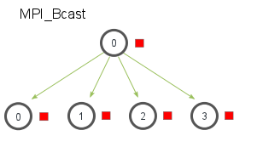
MPI_BCAST
MPI_BCAST distributes data from one process (the root) to all others in a communicator.
main()
{
MPI_Init(&argc,&argv);
MPI_Comm_size(MPI_COMM_WORLD,&numprocs);
MPI_Comm_rank(MPI_COMM_WORLD,&myid);
count=4;
Root = 1
if(myid == Root){
for(i=0;i<count;i++)
buffer[i]=i;
}
MPI_Bcast(buffer,count,MPI_INT,source,MPI_COMM_WORLD);
}

Slide 48
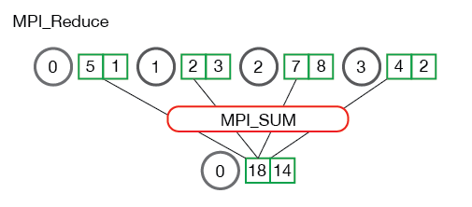
MPI_Reduce
MPI_REDUCE combines data from all processes in communicator and returns it to one process.
main()
{
MPI_Init(&argc,&argv);
MPI_Comm_size(MPI_COMM_WORLD,&numprocs);
MPI_Comm_rank(MPI_COMM_WORLD,&myid);
int val = 10;
int mpi_root = 0;
int total;
MPI_Reduce(&val, &total, 1, MPI_INT, MPI_SUM, mpi_root, MPI_COMM_WORLD);
}
MPI_MAX, MPI_MIN, MPI_SUM, MPI_PROD, MPI_LAND, MPI_BAND, MPI_LOR, MPI_BOR, MPI_LXOR, MPI_BXOR, MPI_MAXLOC, MPI_MINLOC

Slide 49
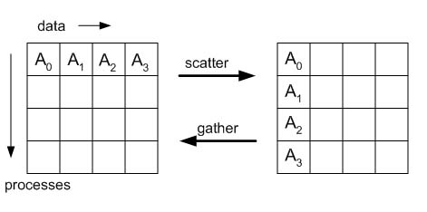
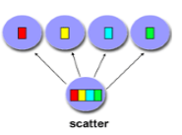
MPI_Scatter/MPI_Gather
0
1
2
3
MPI_Scatter( void* send_data, int send_count, MPI_Datatype send_datatype, void* recv_data, int recv_count, MPI_Datatype recv_datatype, int root, MPI_Comm communicator)
MPI_Gather( void* send_data, int send_count, MPI_Datatype send_datatype, void* recv_data, int recv_count, MPI_Datatype recv_datatype, int root, MPI_Comm communicator)

Slide 50
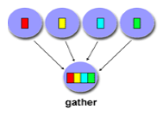
MPI_Scatter/MPI_Gather
0
1
2
3
MPI_Gather( void* send_data, int send_count, MPI_Datatype send_datatype, void* recv_data, int recv_count, MPI_Datatype recv_datatype, int root, MPI_Comm communicator)

Slide 51
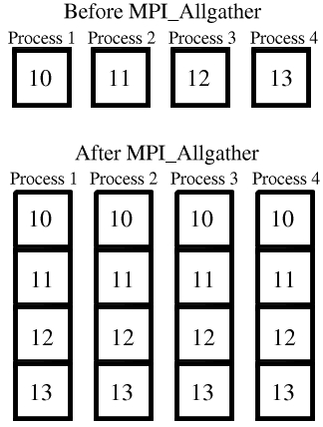
MPI_Allgather

Slide 52
GPGPU Programming
Sonia Gupta
HPC Team, TCS Pune

Slide 53
Introduction - CUDA
General Purpose computation using GPU (GPGPU) in applications other than 3D graphics
GPU accelerates critical path of application
CUDA, OpenCL are being used to program on GPU.
“Compute Unified Device Architecture” (CUDA) - General purpose programming model
CUDA was released on February 15, 2007 for PC and Beta version for MacOS X on August 19, 2008.
Why CUDA:
CUDA provides ability to use high-level languages such as C to develop application that can take advantage of high level of performance and scalability that GPUs architecture offer.
Small set of extensions to enable heterogeneous programming
Straightforward APIs to manage devices, memory etc.

Slide 54
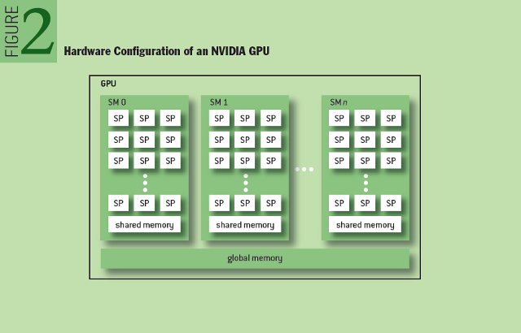
CUDA - Environment
Host
Device
Grid 1
Kernel 1
Block
(0, 0)
Block
(1, 0)
Block
(2, 0)
Block
(0, 1)
Block
(1, 1)
Block
(2, 1)
A kernel is executed as a grid of thread blocks
A thread block is a batch of threads that can cooperate with each other by:
Synchronizing their execution
Efficiently sharing data through a low latency shared memory
Two threads from two different blocks cannot cooperate
Threads will execute inside a SM in group of 32 thread called warp.
Block (1, 1)
Thread
(0, 0)
Thread
(1, 0)
Thread
(2, 0)
Thread
(3, 0)
Thread
(4, 0)
Thread
(0, 1)
Thread
(1, 1)
Thread
(2, 1)
Thread
(3, 1)
Thread
(4, 1)
Thread
(0, 2)
Thread
(1, 2)
Thread
(2, 2)
Thread
(3, 2)
Thread
(4, 2)

Slide 55
CUDA - Memory
Each thread can:
R/W per-thread registers
R/W per-thread local memory
R/W per-block shared memory
R/W per-grid global memory
Read only per-grid constant memory
Read only per-grid texture memory
(Device) Grid
Block (0, 0)
Block (1, 0)
Shared Memory
Shared Memory
Registers
Registers
Registers
Registers
Thread (0, 0)
Thread (1, 0)
Thread (0, 0)
Thread (1, 0)
Local
Memory
Local
Memory
Local
Memory
Local
Memory
The host can R/W global, constant, and texture memories
Host
Global
Memory
Constant
Memory
Texture
Memory

Slide 56
CUDA MEMORY UNITS
Registers:
Fastest.
Only accessible by a thread.
Lifetime of a thread
Shared memory:
Could be as fast as registers if no bank conflicts or reading from same address.
Accessible by any threads within a block where it was created.
Lifetime of a block.
Global Memory:
Up to 150x slower then registers or share memory.
Accessible from either host or device.
Lifetime of an application.
Local Memory
Resides in global memory. Can be 150x slower then registers and shared memory.
Accessible only by a thread.
Lifetime of a thread.

Slide 57
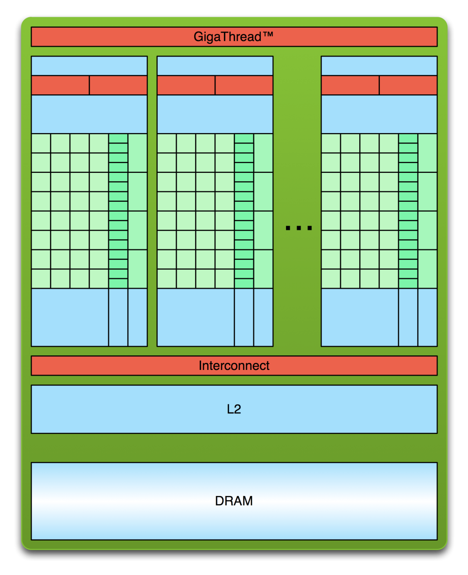
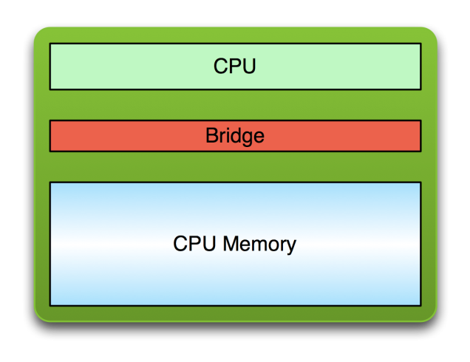
CUDA - Basics
PCI Bus
At application start of execution CUDA's compiled code runs like any other application. Its primary execution is happening in CPU.
When kernel call is made, application continue execution of non-kernel function on CPU. In the same time, kernel function does its execution on GPU. This way we get parallel processing between CPU and GPU.
Memory move between host and device is primary bottleneck in application execution. Execution on both is halted until this operation completes.

Slide 58

CUDA - Example
__global__ void mykernel(void){}
int main(void) {
mykernel<<<1,1>>>();
printf("Hello World!\n");
return 0;
}
Triple angle brackets mark a call from host code to device code
Compilation:
$ nvcc hello.cu
Execution
$ a.out
Hello World!
$
nvcc separates source code into host and device components
__global__ defines a kernel function and Must return void
__device__ (device function) and __host__ (Host function) can be used together

Slide 59
CUDA - memcpy
Allocate Memory on Device
cudaMalloc() – allocate memory in Global memory
cudaFree()
cudaMalloc((void**)&Md.elements, size);
cudaFree(Md.elements);
Transfer memory from Device to Host and vice versa
cudaMemcpy()
cudaMemcpy(Md.elements, M.elements, size, cudaMemcpyHostToDevice);
cudaMemcpy(M.elements, Md.elements, size, cudaMemcpyDeviceToHost);

Slide 60
CUDA – Kernel Launch
A kernel function must be called with an execution configuration:
__global__ void KernelFunc(...);
dim3 DimGrid(4, 0); // 4 thread blocks
dim3 DimBlock(8, 0, 0); // 8 threads per block
KernelFunc<<< DimGrid, DimBlock>>>(...);
Any call to a kernel function is asynchronous from CUDA 1.0 on, explicit synch needed for blocking.
On device, these calls will be processes in synchronous manner.
Each thread has it local ID and global ID.
int index = threadIdx.x + blockIdx.x * blockDim;
Arguments to pass
threadIdx.x
threadIdx.x
threadIdx.x
threadIdx.x
Local Index
0
1
2
3
4
5
6
7
0
1
2
3
4
5
6
7
0
1
2
3
4
5
6
7
0
1
2
3
4
5
6
7
blockIdx.x = 0
blockIdx.x = 1
blockIdx.x = 2
blockIdx.x = 3

Slide 61
CUDA - Thread ID
0
1
2
3
4
5
6
7
8
9
10
11
12
13
14
15
16
17
18
19
20
21
22
23
24
25
26
27
28
29
30
31
threadIdx.x = 5
threadIdx.x
threadIdx.x
threadIdx.x
threadIdx.x
0
1
2
3
4
5
6
7
0
1
2
3
4
5
6
7
0
1
2
3
4
5
6
7
0
1
2
3
4
5
6
7
blockIdx.x = 0
blockIdx.x = 1
blockIdx.x = 2
blockIdx.x = 3
int index = threadIdx.x + blockIdx.x * blockDim.X;
= 5 + 2 * 8;
= 21;

Slide 62
CUDA – 2D Block and Thread Dim
__global__ void KernelFunc(...);
dim3 DimGrid(2, 2);
dim3 DimBlock(4, 4, 0);
Grid 1
Block 1
Block 2
int indexX = threadIdx.x + blockIdx.x * blockDim.X;
int indexY = threadIdx.y + blockIdx.y * blockDim.Y;
Thread
(2, 2)
Block 3
Block 4
void __syncthreads();
Synchronizes all threads within a block

Slide 63
CUDA ERROR Handling
For non-kernel CUDA calls return value of type cudaError_t is provided to requestor. Human-radable description can be obtained by char* cudaGetErrorString(cudaError_t code);
CUDA also provides method to retrieve last error of any previous runtime call cudaGetLastError(). There are some considirations:
Use cudaThreadSynchronize() to block for all kernel calls to complete. This method will return error code if such occur. We must use this otherwise nature of asynchronous execution of kernel will prevent us from getting accurate result.

Slide 64
Example
__global__ void add(int *a, int *b, int *c) {
c[threadIdx.x] = a[threadIdx.x] + b[threadIdx.x];
}
#define N 512
int main(void) {
int *a, *b, *c; // host copies of a, b, c
int *d_a, *d_b, *d_c; // device copies of a, b, c
int size = N * sizeof(int);
// Alloc space for device copies of a, b, c
cudaMalloc((void **)&d_a, size);
cudaMalloc((void **)&d_b, size);
cudaMalloc((void **)&d_c, size);
// Alloc space for host copies of a, b, c and setup input values
a = (int *)malloc(size); random_ints(a, N);
b = (int *)malloc(size); random_ints(b, N);
c = (int *)malloc(size);

Slide 65
Example – ctd..
// Copy inputs to device
cudaMemcpy(d_a, a, size, cudaMemcpyHostToDevice);
cudaMemcpy(d_b, b, size, cudaMemcpyHostToDevice);
// Launch add() kernel on GPU with N threads
add<<<1,N>>>(d_a, d_b, d_c);
// Copy result back to host
cudaMemcpy(c, d_c, size, cudaMemcpyDeviceToHost);
// Cleanup
free(a); free(b); free(c);
cudaFree(d_a); cudaFree(d_b); cudaFree(d_c);
return 0;
}

Slide 66
Latest features
Dynamic Parallelism: GPU thread to launch a parallel GPU kernel
HyperQ: 32 concurrent work queues. Multirank MPI parallelism.
NVLink: world’s first high-speed GPU interconnect - It will connect the machines’ processors – CPUs and GPUs – so they can exchange data 5 to 12 times faster.
Unified Memory: Creates a pool of managed memory shared between the CPU and GPU, bridging the CPU-GPU divide. Managed memory is accessible to both the CPU and GPU using a single pointer.
XT Libraries: provide automatic scaling of cuBLAS level 3 and 2D/3D cuFFT routines to 2 or more GPUs.
GPU Direct: Use high-speed DMA transfers to copy data between the memories of two GPUs on the same system/PCIe bus.

Slide 67
CUDA Optimizations
Reduce Kernel Overhead
Reduce memory copy overhead
Understand memory access pattern and read Global memory in coalesced memory access pattern
Use Shared memory for data that is being used frequently.
Overlap communication and computation.
Use constant memory for data that will not change in entire program
Avoid divergence in GPU section.

Slide 68


Slide 69
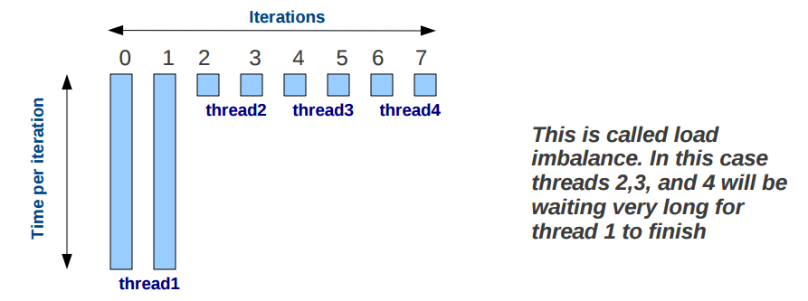
Issues with static scheduling
With static scheduling the number of iterations is evenly distributed among all openmp threads (i.e. Every thread will be assigned similar number of iterations). This is not always the best way to partition.

